Slide 1
Library partnership a discussion

Slide 2

afpls.org/digitallibrary
Click “children”

Slide 3
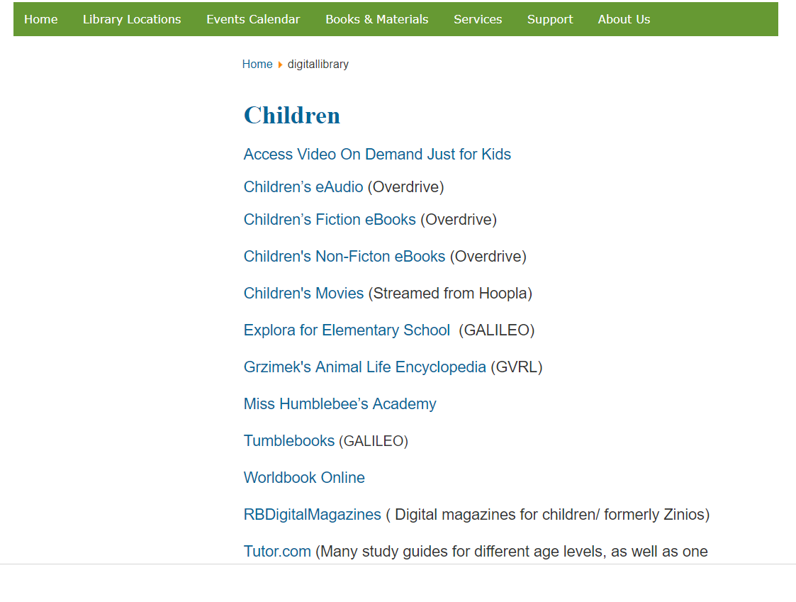

Slide 4
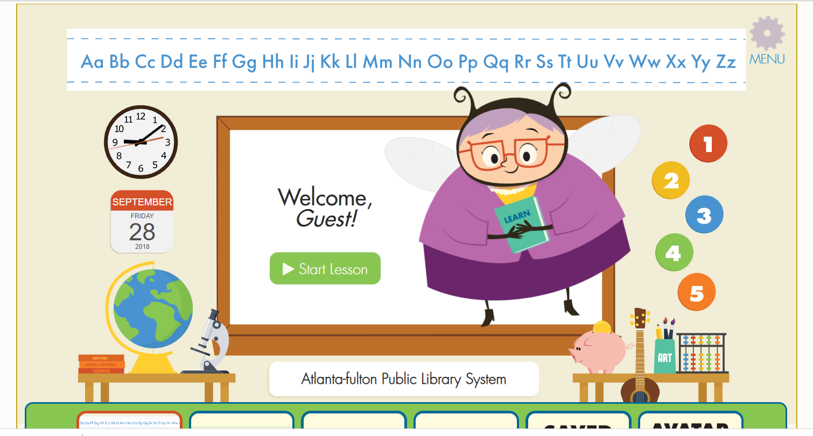

Slide 5
Survey
Visits from librarians to talk to teachers, students and parents about library resources
    during school hours
    after hours
Handouts in media centers reviewing library resources
Booklists of recommended titles for each grade level
Digital/Online resources that the library can provide to teachers/students

Slide 6
Visits from librarians to talk to teachers, students and parents about library resources
    during school hours
    after hours
Handouts in media centers reviewing library resources
Booklists of recommended titles for each grade level
Digital/Online resources that the library can provide to teachers/students

Slide 7
Other Resources: Let’s Discuss!

Slide 9

Thank you!
Amanda Densmore
amanda.densmore@fultoncountyga.gov
404-692-9785

