Slide 1

Gwinnett Parent Coalition to Dismantle the School to Prison Pipeline
Notes:
Intro the team.

Slide 2

Agenda
Introduction
STPP Overview
Connecting the Dots: Discussion on the criminalization of youth
STPP Impact
Strategies to Interrupt the STPP
Closing

Slide 3
OUR WORK
Public Education
Advocacy/Policy Change
Analyze policies
Data collection to demonstrate Pipeline effects
Build relationships and expand network
Notes:
Gwinnett SToPP is a grassroots parent organizing group that works to dismantle the STPP in Gwinnett County GA.
Our work fits into two buckets: public education/awareness and advocacy for policy changes.
We run a Parent Leadership Institute, Youth Leadership Institute, as well as stand-alone workshops to educate the public.
A couple of more recent policy wins around police in schools are the elimination of the contact quota for SRO’s
This past year, Gwinnett SToPP was successful in reducing the number of disciplinary infractions that could garner police interaction by 33%.

Slide 4
What is the School To Prison Pipeline?
The school to prison pipeline (STPP) is a national trend wherein children are funneled out of public schools and into the juvenile and criminal justice systems.

Slide 5
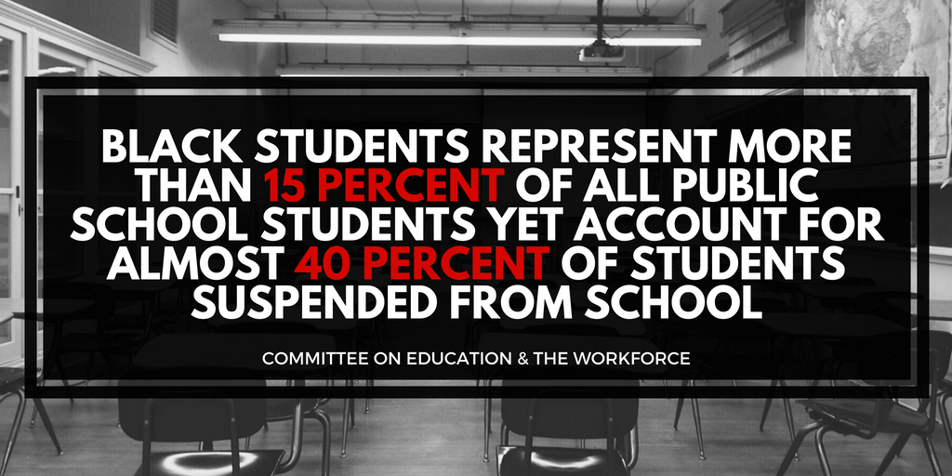
National

Slide 6
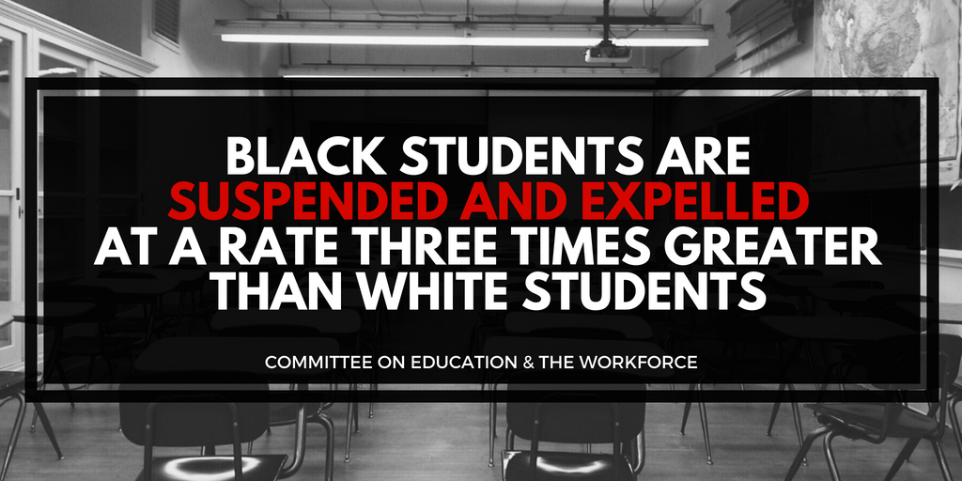
National

Slide 7
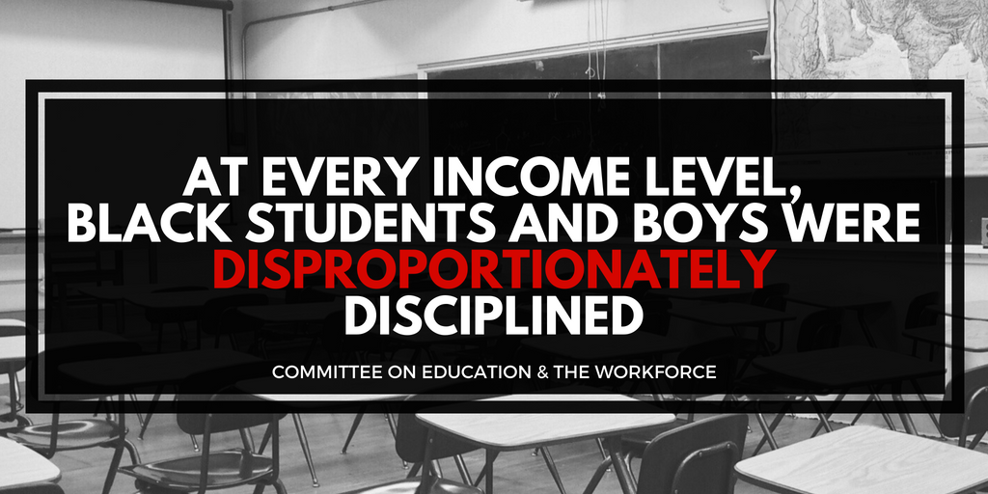
National

Slide 8
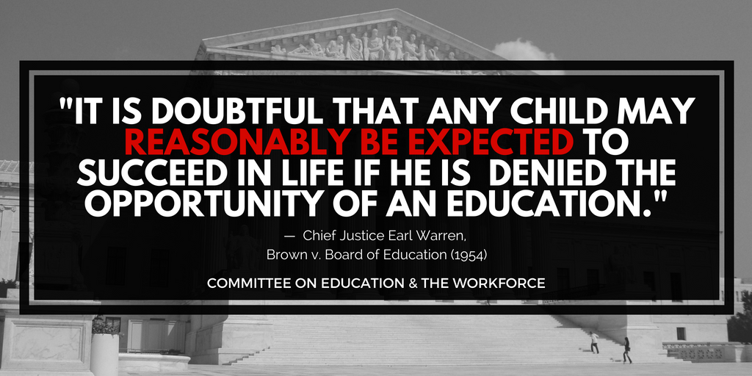

Slide 9
Pair Share: Do Police Make Schools Safer?

Slide 10
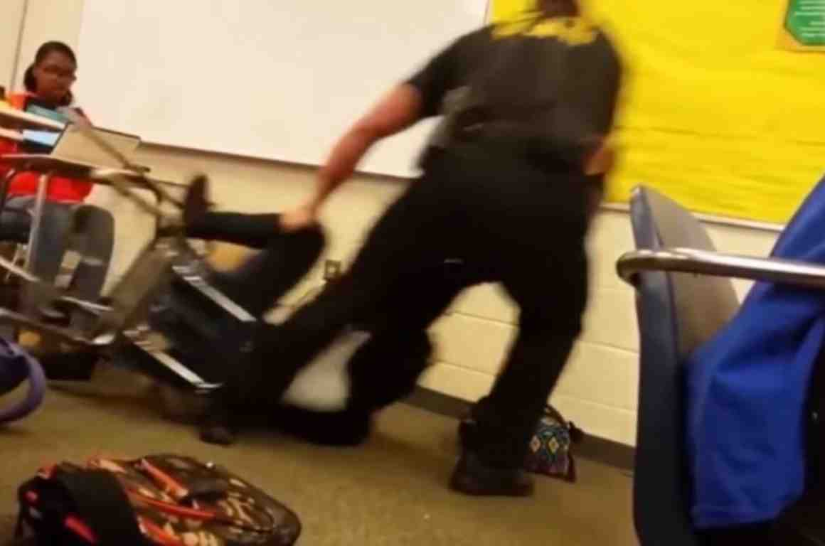

Are Students Safer with Police?

Slide 11
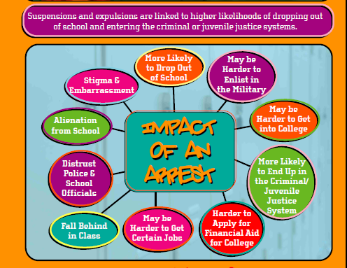
IMPACT OF STPP
Adapted from “Telling It Like It Is”, Advancement Project & Power U

Slide 12
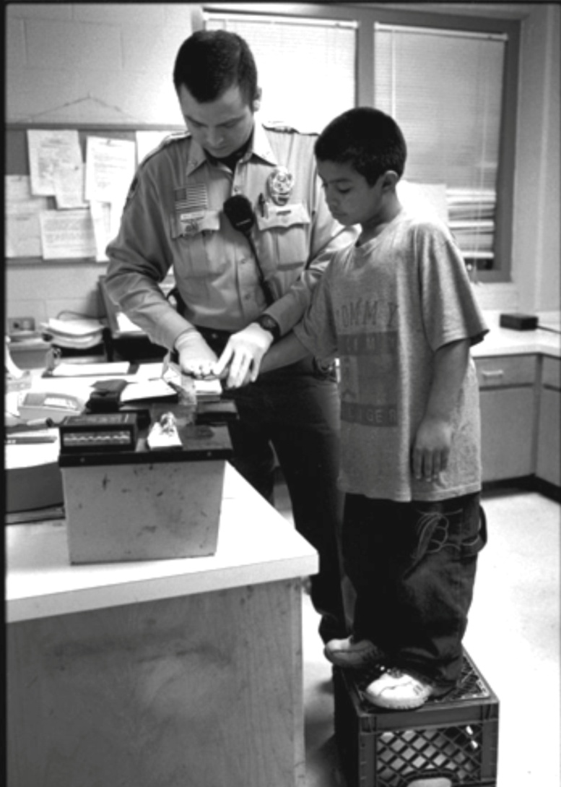
Too Young to Suspend?
Notes:
Discuss

Slide 13
Resources
Dignity In Schools Campaign
    Counselors Not Cops
    www.dignityinschools.org/counselors-not-cops
      Model Code
      http://www.dignityinschools.org/our-work/model-school-code
Justice Policy Institute
    Measured Responses: Why increasing law enforcement in schools is not an effective public safety response to the Newtown tragedy. www.justicepolicy.org/uploads/justicepolicy/documents/schoolsafetyfactsheet.pdf
ACLU
Know Your Rights: What To Do When Encountering the Police (for Youth)
https://www.aclu.org/know-your-rights/what-do-when-encountering-police-youth
ACLU of Pennsylvania
https://www.aclupa.org/issues/studentyouthrights/police-and-schools/
Notes:
DSC - Contains a resource guide of FAQs, data and an interactive webpage featuring our recommendations, key statistics and graphics.
Justice Policy Institute –great information on why increasing law enforcement in schools does not equal safety.
ACLU – has a student’s KYR guide for school police. The ACLU of Pennsylvania, a DSC member, has a lot of resources on police in schools. Harold Jordan, their Senior Policy Advocate, has done a lot of work around school policing.

Slide 14

Opportunities
  Parent Education Workshops
  School Board Candidate Forum
  October 16th, GJAC, 6:30pm-9pm
  Dignity in Schools Campaign National Week of Action
    Oct. 20th -27th
    **** Gwinnett Event October 27th ****
    Lockers to Lockdown: Black Boys, Special Education and the School to Prison Pipeline
    In collaboration w/GCDD & ICM
    https://lockers2lockdown.eventbrite.com
    GCDD/GSToPP/ICM DeKalb Event Nov. 10th
Notes:
GCDD-Georgia Council of Developmental Disabilities
ICM – Interfaith Children’s Movement

Slide 15


Contact Us
Gwinnett Parent Coalition to
Dismantle the School to Prison Pipeline
(Gwinnett SToPP)
info@GwinnettSToPP.org
  www.GwinnettSToPP.org
  Follow us!
  @GwinnettSToPP Gwinnett.STOPP

Slide 16

Questions????

