Slide 1


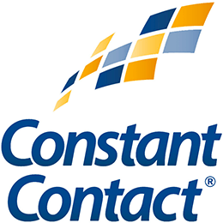
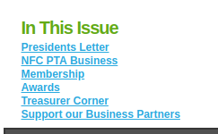
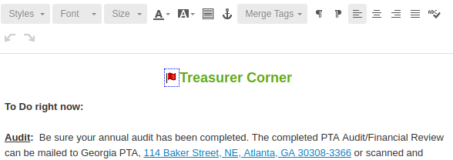
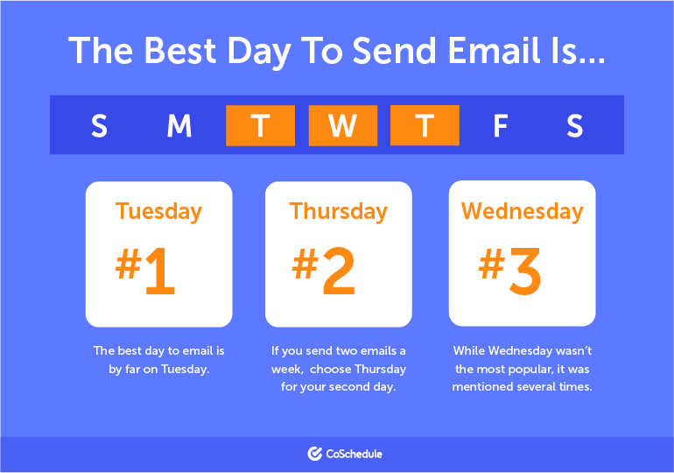
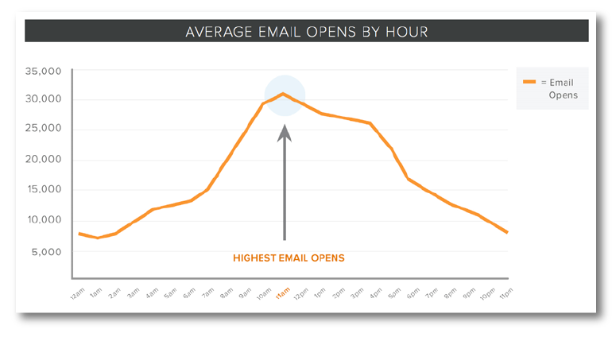
Mass Communication with your Members – A Guide
The tools:
Regular email is fine for a small list (25 people)
For a school wide eNewsletter, you want to use an online tool
We recommend MailChimp – easy to use, and does a good job of managing contacts, and you can import/export lists.
Other options (there are many more on the web):
Benchmark Constant Contact
l
The content:
Newsletters: Lots of content, images, and links. Too long, and often blocked by filters. Low open rate (less than 25%).
Tip: Provide a menu (left) to allow people to jump to content (right) they are interested in. Use the Anchor icon in the email builder, and link to its name.
Announcements: One topic, short and to the point. No images, only 1-2 links. Higher open rate (40%).
Tip: Don't make it too long – your audience does not want to scroll down on their phone. Use announcements when you want people to take action – Show up, Vote, Take a survey, Volunteer, Sign up, Join us, etc. Send no more than two/week.
The schedule:
The best time to send emails is around 10 a.m. on a Tuesday.

