Slide 1
Not Your Average School Year:
Sharing, Learning, Growing

Slide 2
Caroline Durham Legal and Policy Director KyMara Guidry Equal Justice Works Fellow

Slide 3
TODAY’S FOCUS IS THE NEW SCHOOL YEAR
School is Home. Home is School
You are the teacher more than ever.
Extra layers in getting to class.

Slide 4
Post-Training Survey
We will share a survey at the end of this training. Please complete the survey so we can hear from you about this presentation and additional topics of interest for future trainings.
https://www.surveymonkey.com/r/AFYC

Slide 5
About Georgia Appleseed
Advances justice for all Georgia’s children with
particular focus on
children experiencing poverty,
children with disabilities, and
children who experience the effects of institutional bias and racism.
Justice requires that every child has access to strong, nurturing schools and a healthy home.

Slide 6
Our Current Priority Issues
Keeping Kids in School and Out of the Criminal Justice System
Promoting Supports for Students with Behavior and Learning Challenges
Ensuring Children and Families have Safe and Healthy Housing
CHILDREN IN CARE

Slide 7
Getting Grounded
Take time each day to ground. Take time throughout the day to ground.
Know that what you see, hear, sense about your child is valid.

Slide 8
Let’s Rethink Responses to Behavior . . . .

Slide 9
PRODUCTIVE LEARNING ENVIRONMENTS: Effective and Smart DISCIPLINE Changes Negative Behavior Into Positive Behavior
Behavior is learned and can be taught
Behavior is predictable
Behavior is maintained by consequences
Punishment does not teach appropriate behavior

Slide 10
If a child is struggling in school, they may have a learning or behavior challenge that could be related to:
Mental Health Challenges
Anxiety
Depression
Attention Deficit/Hyperactivity Disorder
Post-Traumatic Stress Disorder

Slide 11
BEHAVIOR AND LEARNING CHALLENGES
If a child is struggling in school, they may have a learning or behavior challenge that could be related to:
Mental Health Challenges
Trauma
Anxiety
Depression
Attention Deficit/Hyperactivity Disorder
Post-Traumatic Stress Disorder
Sad, violent, or scary events , like this pandemic, that may have long term effects on a child’s behavior

Slide 12
BEHAVIOR AND LEARNING CHALLENGES
If a child is struggling in school, they may have a learning or behavior challenge that could be related to:
Mental Health Challenges
Trauma
Physical and Mental Disabilities
Anxiety
Depression
Attention Deficit/Hyperactivity Disorder
Post-Traumatic Stress Disorder
Sad, violent, or scary events , like this pandemic, that may have long term effects on a child’s behavior
Physical and mental challenges that may make it hard to learn or follow rules

Slide 13
BEHAVIOR AND LEARNING CHALLENGES
If a child is struggling in school, they may have a learning or behavior challenge that could be related to:
Mental Health Challenges
Trauma
Physical and Mental Disabilities
Learning Disabilities
Anxiety
Depression
Attention Deficit/Hyperactivity Disorder
Post-Traumatic Stress Disorder
Sad, violent, or scary events , like this pandemic, that may have long term effects on a child’s behavior
Physical and mental challenges that may make it hard to learn or follow rules
Specific challenges that make it hard to learn at school

Slide 14
BEHAVIOR AND LEARNING CHALLENGES
If a child is struggling in school, they may have a learning or behavior challenge that could be related to:
Mental Health Challenges
Trauma
Physical and Mental Disabilities
Learning Disabilities
Language Impairments
Anxiety
Depression
Attention Deficit/Hyperactivity Disorder
Post-Traumatic Stress Disorder
Sad, violent, or scary events , like this pandemic, that may have long term effects on a child’s behavior
Physical and mental challenges that may make it hard to learn or follow rules
Specific challenges that make it hard to learn at school
Trouble speaking or understanding words or speech

Slide 15
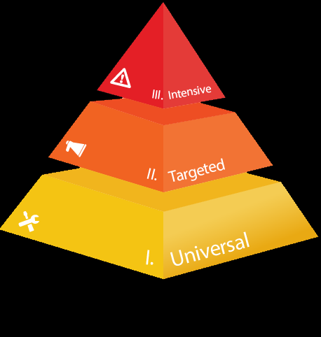
…Schools can help
SCHOOL SUPPORTS FOR BEHAVIOR AND LEARNING CHALLENGES
Ask for:
Student Support Teams
Behavior Intervention Plans and Functions Behavioral Assessments
Section 504 Plans
Special Education Services
Behavioral Health Supports
Multi-tiered Systems of Support

Slide 16
SCHOOL SUPPORTS FOR BEHAVIOR AND LEARNING CHALLENGES
Student Support Team
Functional Behavior Assessment and Behavior Intervention Plan
Section 504 Plans
Special Education and IEPs
Behavioral Health Services in School
Multi-Tiered System of Supports

Slide 17
Educational Programming, Assessment and Consultation (EPAC)
Work with your Education Support Monitor (ESM) to identify school and community services available to children who may have a behavior or learning challenge
Check with your ESM to see how they can support youth facing short- or long-term exclusionary discipline

Slide 19
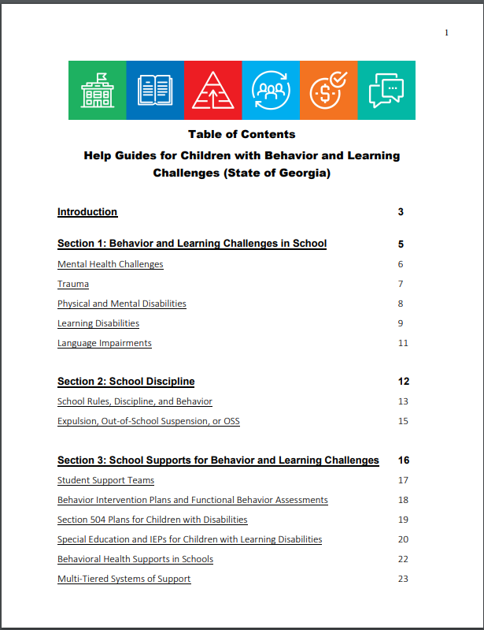
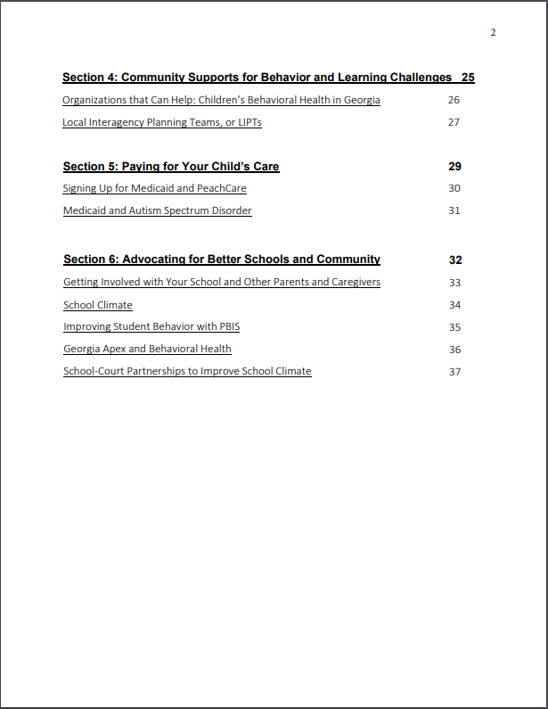

Slide 20
Special Education: The Basics
Identification
Evaluation
Eligibility
Placement

Slide 21
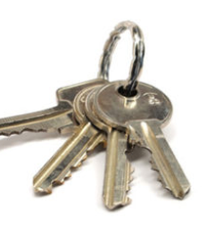
Special Education Keys
Child/Family Has Rights
Child Should Be Able to Learn
Least Restrictive Environment
Appropriate Evaluation
Parent is part of Team &
Child Can Attend

Slide 22
What is the Least Restrictive Environment (LRE)?
Least Restrictive
Most Restrictive
General Education Classroom without Special Education Supports
General Education Classroom with Special Education Supports
Self Contained Special Education Classroom
Separate, Specialized School.

Slide 23
Practical Tips: Special Education
Get
Get evaluations before SST or IEP meeting. Read them. Highlight what is important.
Plan
Plan what you want to request before you walk in, but then allow process to inform you along the way.
Take
Take breaks or request an additional meeting if necessary.
Bring
Bring mental health counselors to IEP.
Have
Have doctor or other professional write out what is needed if they cannot come.

Slide 24
COMMUNITY SUPPORTS FOR BEHAVIOR AND LEARNING CHALLENGES
Counseling
Wrap Around
Clubhouses
Autism Supports

Slide 25
Medicaid Rights
Evaluations & Screenings
Treatment
Appeal

Slide 26
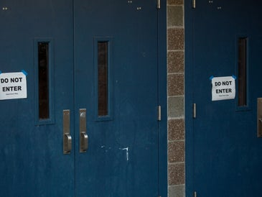
What happens if a child is facing a Tribunal?
Student is entitled to dispute the proposed disciplinary action at an administrative hearing often called a “Tribunal”.
Visit https://gaappleseed.org/publications for more information.

Slide 27
10 Day Rule
Suspension for 10 days or less = No added protections
Suspension for more than 10 days = Added layer of protection

Slide 28
EXPULSION, OUT-OF-SCHOOL SUSPENSION, OR OSS
General Education Student
Removal for more than ten CONSECUTIVE days
Tribunal
Special Education Student
Removal for more than ten CUMULATIVE days
Manifestation Determination Review
Tribunal or IEP Meeting
Discuss whether the alleged conduct is related to the child’s disability OR
Whether the school failed to implement the child’s IEP
Decides whether student broke rules and if so, the punishment

Slide 29
Expulsion, Out-of-School Suspension or OSS
When is this an issue?
What if the child is in special education?
When children break certain rules, disrupt class, causes danger or otherwise violates the school’s code of conduct
If the proposed punishment is more than ten days, the school will have a meeting called a Tribunal.
The school cannot remove the child for more than ten days total each year without having a manifestation determination review
If the disability caused the behavior, the school cannot suspend or expel

Slide 30
Manifestation Determination Reviews
What is the purpose of the MDR?
What are the MDR Procedures?
Gather the IEP Team
Discuss whether the alleged conduct is caused by or directly related to the child’s disability OR
Whether the school failed to implement the child’s IEP
Like the tribunal, must occur within ten days of the alleged violation
The attendees are the same as the IEP meeting
Ga. Comp. R. & Regs. r. 160-4-7-.10(12):
Notes:
Consider compensatory education

Slide 31
Manifestation Determination Review Results
Behavior IS a Manifestation of Disability
Behavior is NOT a Manifestation of Disability
School cannot suspend the student.
The IEP must be amended.
School can move forward with the suspension or expulsion of the student.
Parents have a right to appeal this decision.

Slide 32
Manifestation Determination Review
What does the MDR Review?
How can you prepare?
The child’s IEP
Psychological evaluations
Functional behavior assessments and/or behavior intervention plans, if applicable
Disciplinary history
Data as it relates to the child’s behavior intervention plans, if applicable
Consider whether notice was given
Review the child’s school records, in particular the IEP
Ask questions of all of the participants.
Is this the first time? What happened other times?
IS there a BIP? Was it followed?
Psychologist: how does the disability impact behavior
Bring outside psychological evaluations if they exist and include evaluator if possible
Notes:
Parent
School teachers
Special education administrator (from the school and district)
School psychologist
Providers who work with the child outside of school
If the parent brings an attorney, the attorney for the school will attend

Slide 33
School Tribunal Hearings
What is the purpose of the Tribunal?
What are the tribunal procedures?
To determine whether the alleged conduct occurred and if so, to determine the appropriate punishment
Held in front of a neutral hearing officer
Determination of Guilt
Witnesses and evidence from the school district
Potential defenses for the child
Determination of Punishment
Review of placement options
Decision can be appealed ->LEA Board ->Superintendent ->Superior Court
Notes:
What does the child’s IEP state as it relates to behavior?
Eligibility category
Present levels of performance
Behavior intervention plan
Behavior goals
Behavior accommodations
Meeting minutes
Services as it relates to behavior

Slide 34
Why the Tribunal Matters
Child may be wrongly accused.
School records are impacted.
Increased loss of school days.
Moved to new foster home.
Criminal charges may be filed.
Students of all ages can be expelled indefinitely.

Slide 35
Tribunal Process An Overview
Alleged offense occurs, school begins investigation, and child is suspended for up to 10 days
Notice/charge letter is sent to guardian with offense(s), date for tribunal hearing, and school’s preferred outcome
If the child receives special education services, a Manifestation Determination Review occurs
Tribunal hearing occurs with hearing officer, school administration, witness(es) guardian, child, and possibly attorney
Hearing officer renders decision either party can appeal (usually return to school, extended suspension, alternative placement, expulsion)

Slide 36
Before the Tribunal: Preventive Advocacy
Check with school, child, and guardian to identify
what supports were in place before the alleged offense occurred.
Contact school administration to determine the
available tribunal alternatives
e.g. behavioral contracts, increased health supports, schedule change, etc.

Slide 37
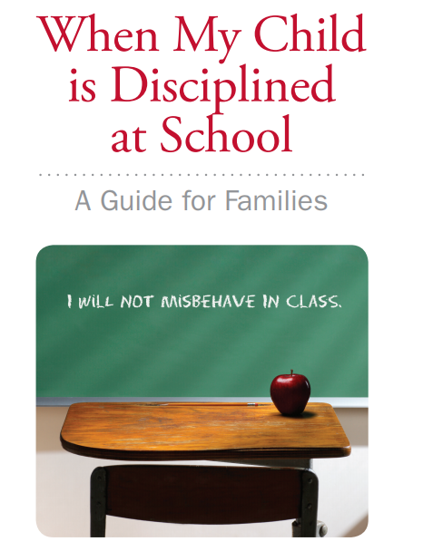
RESOURCES & SUPPORTS
To refer a child, visit www.gaappleseed.org/referral
Notes:
Hold up the hand out.
In Spanish, too. PLUS the bullying supplement.

Slide 38
EFFECTIVE STUDENT DISCIPLINE RESOURCES
Data can be found in the Georgia Appleseed “Effective Student Discipline Keeping Kids in Class Tool Kit.”
www.gaappleseed.org/toolkit/
Notes:
It is all found in the Keeping Kids in Class Toolkit! (Go through the buttons if have time)

Slide 39
Post-Training Survey
Please complete the survey so we can hear from you about this presentation and additional topics of interest for future trainings.
https://www.surveymonkey.com/r/AFYC

Slide 40
Any Questions?

Slide 41
Visit Our Website or Contact Us for Additional Resources and Supports!
www.GaAppleseed.org
Caroline Durham| cdurham@gaappleseed.org | (678) 336-7233
Kymara Guidry| kguidry@gaappleseed.org | (678) 336-7213
FOLLOW US:
On Facebook: www.facebook.com/GeorgiaAppleseed
On Twitter: twitter.com/gaappleseed or @gaappleseed
On the web: www.Gaappleseed.org

