Slide 1



Slide 2

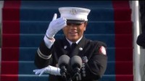

Give Away Contributor:

Slide 3
Mission Statement
Every Child. One Voice.
PTA's mission is to make every child’s potential a reality by engaging and empowering families and communities to advocate for all children.

Slide 4
Values
Collaboration
Commitment
Diversity
Respect
Accountability

Slide 5
Agenda and
Minutes

Slide 6
Treasurer Report

Slide 7
District 10 Board

Slide 8
GA PTA District 10
(3 Councils)
Atlanta Council
(63)
South Council
(37)
North Council
(33)
Georgia PTA
Local Units

Slide 9
Let’s Transition

Slide 10
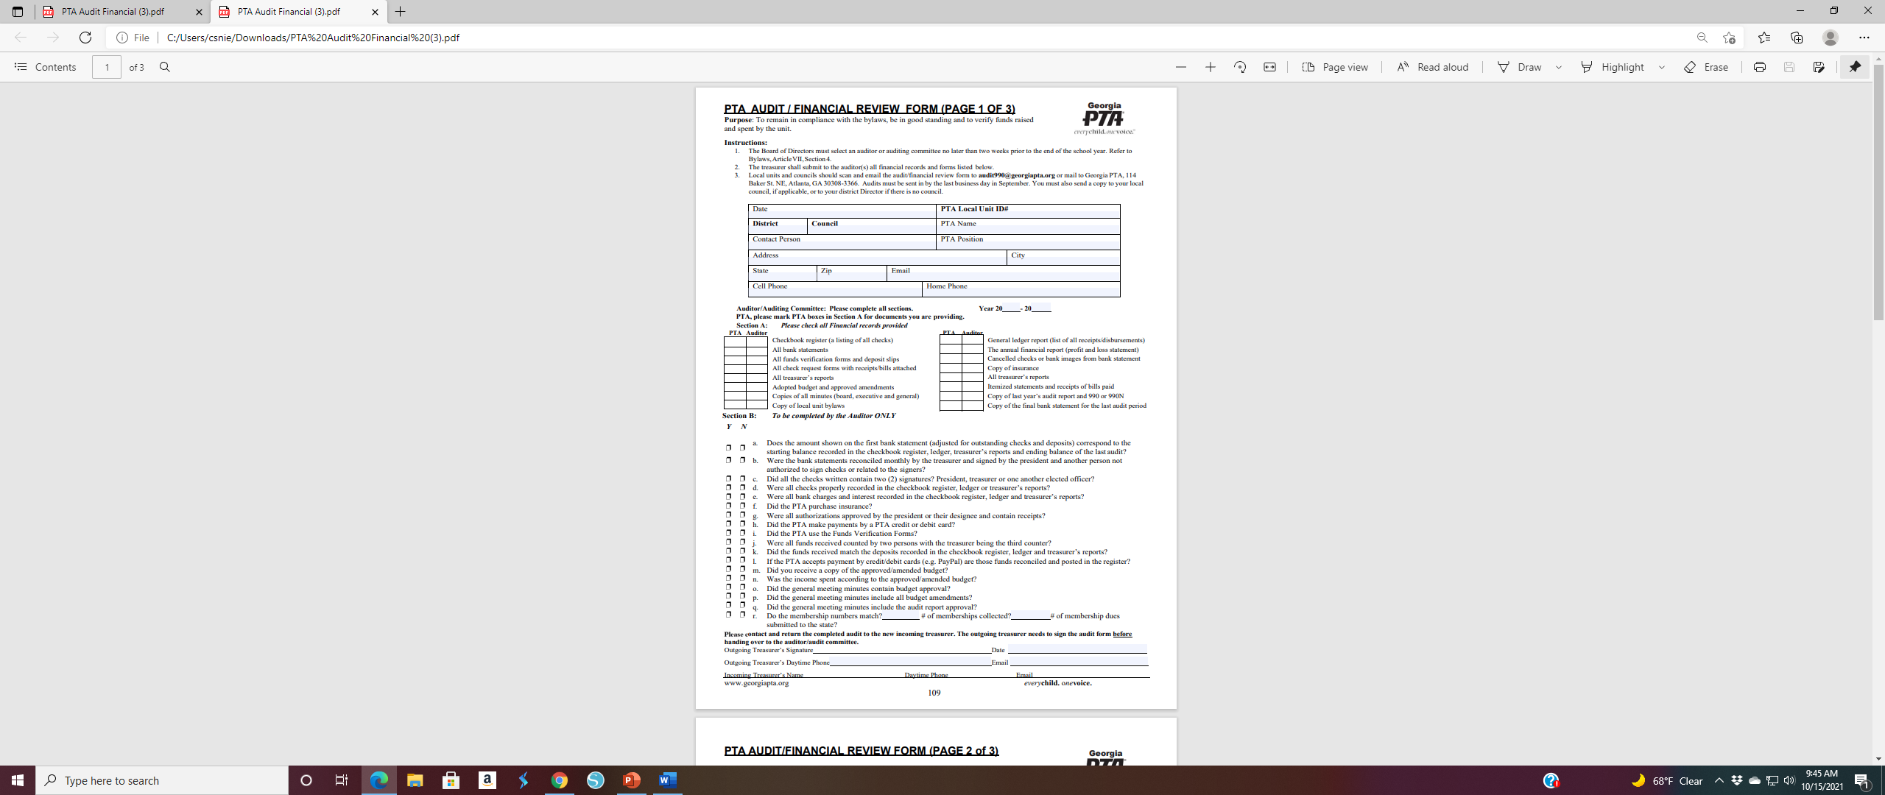
PTA Financial Review Form
Due by the last business day in September

Slide 11
Celebration and
Give-Aways

Slide 12

Reflections

Slide 14
Placed in State Competition

Slide 15


